Slide 1




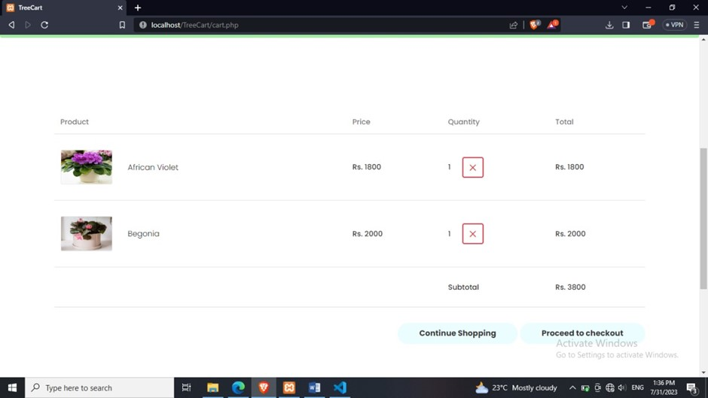
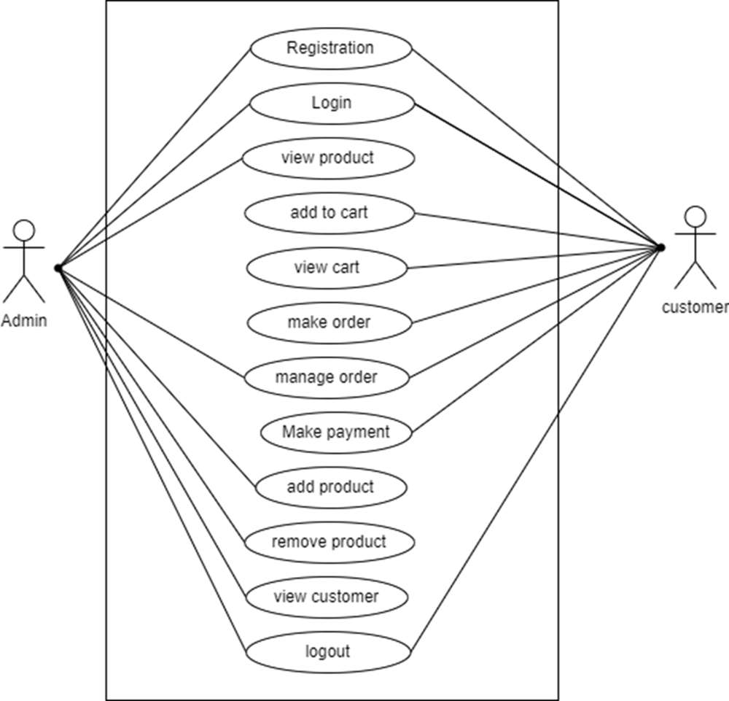
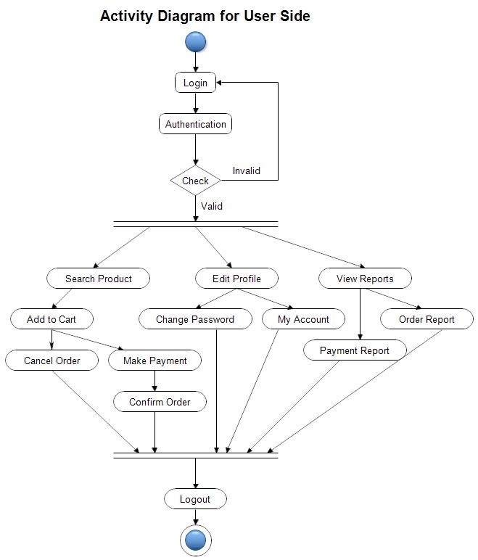
and convenient tree-buying experience."
KJ's Educational Institute
TRINITY ACADEMY OF ENGINEERING, PUNE
Project Exhibition AY 2023-24
Department : MCA (ENGINEERING)
and convenient tree-buying experience."
Project Title: “TREECART”
Aim: Develop a user-friendly online platform that enables customers to browse a diverse selection of trees make secure purchases and convenient tree-buying experience.
Objective:
i) Enhance Customer Experience
ii) Expand Customer Reach
Introduction
Results & Discussions (Figs/Tabular/Graph/Bar Chart)
Treecart is the online nursery plant store is web based system that comfort and convenience of your homes. With this web based system customer can view the plants with details such as plants cost etc.
Block Diagram/Flow Chart/Methodology
j
Experimental Model/Design Formula /Numerical analysis
Conclusions
In conclusion, the proposed enhancement of the nursery store system aims to address the limitations of the existing system and provide an improved online shopping experience for customers
Group No . 07 Guided By :Prof.Dipali.A.Bhusari
Student Name:
1. Aniket Sarjine 2.Gaurav Tilekar 3.Harshad Borkar
Important references/Publication details
Books: ”E-commerce 202X
Academic Journals and Papers: ”E-commerce website

